Slide 1
DATA SCIENCE CAPSTONE · MSDS640
Adult Census Income
Final Model Comparison and Fairness Audit
Erik Herb
M.S. Data Science · Bryant University
Notes:
This is the final milestone of my capstone. The dataset is the UCI Adult Census Income data from 1994, about 32,500 rows, and the task is predicting whether somebody earns over 50 thousand a year. In the last milestone I built the logistic regression baseline. Today I add XGBoost and a multilayer perceptron, compare all three with statistical tests and not just eyeballed differences, and run a fairness audit across nativity and sex. The short version up front: two of my three hypotheses are supported and one is refuted, and the refuted one is the most interesting result in the project. The shape of the next 25 minutes is setup and methodology first, then the model comparison with the tests behind it, then the fairness audit and the three verdicts, then limitations and what I would do next.

Slide 2
1
The problem and the three hypotheses
A lender flagging likely high earners, so recall and fairness matter more than accuracy
THE PREDICTION TASK
WHY THE FRAMING DECIDES THE METRICS
Predict over-$50K income from demographic, education, and job data.
Imbalanced target: 24.1% high earners, 75.9% low
A missed high earner is lost business, and a denied opportunity
So PR-AUC and recall lead, accuracy is secondary
More misses in one group means the model works worse for that group
So fairness is measured alongside accuracy, not after
H1
Education over hours
H2
XGBoost is the fairest
H3
XGBoost classifies best
Education predicts over-$50K income more strongly than hours worked.
XGBoost has the smallest US-born vs foreign-born recall gap.
XGBoost beats both on PR-AUC and F1. The data is non-linear, and 32.5K rows is small for a neural network.
Permutation importance, with a CI on the difference.
Bootstrap CIs on each gap and on the difference.
Paired t-tests, McNemar, and paired bootstrap.
Notes:
The whole project is built around three hypotheses and each one is testable. H1 is a drivers question about education versus hours. H2 is the fairness question. H3 is the model comparison, and I want to flag the reasoning I stated up front, before I saw any results: my EDA found real non-linear structure, curves in age, threshold effects in capital gain, and interactions between education and marital status, which is what boosted trees are good at. And 32,500 rows is small for a neural network. So the dataset size and the shape of the structure both point at XGBoost over either of the other two.

Slide 3
2
Data and preprocessing
Carried forward from the earlier milestones
THE DATASET
WHAT I DID AND WHY
UCI Adult Census Income, 1994 U.S. Census
32,561 rows, 15 columns, one person per row
One snapshot in time, so no temporal split applies
Public and anonymized
After cleaning: 32,537 rows, 52 model columns
Missing values filled with an Unknown category
Three columns have missing values, all under 6%
Dropping them loses ~2,400 people, and the missingness is not random
24 exact duplicates dropped, sampling weight still in the table
The weight is near-unique per row, so the order mattered
Every IQR-flagged outlier kept
Dropping them costs 39.7% of the data and 47.2% of all high earners
ENCODING, SCALING, AND CLASS IMBALANCE
One-hot on the 8 categorical variables, first level dropped: 52 columns to avoid redundancy
Scaling on the 5 continuous columns only
SMOTE on training rows only
Both live inside the pipeline, so they never see a held-out row
Notes:
This is all carried forward, so I will not spend long here. Three columns had gaps and I filled them with Unknown instead of dropping about 2,400 people. I kept every outlier because I measured what dropping them would cost, and the flagged rows are disproportionately the high earners I am trying to find. If anyone asks about the 27.7 percent flag rate on hours, that is the rule and not the data: 46 percent of people work exactly 40 hours, which squeezes the fence down to 32 to 52, so a 55 hour week gets called an outlier. The one thing worth pausing on is the last bullet: the scaler and SMOTE live inside the pipeline, which is what makes leakage hard to cause by accident instead of something I have to remember to avoid.

Slide 4
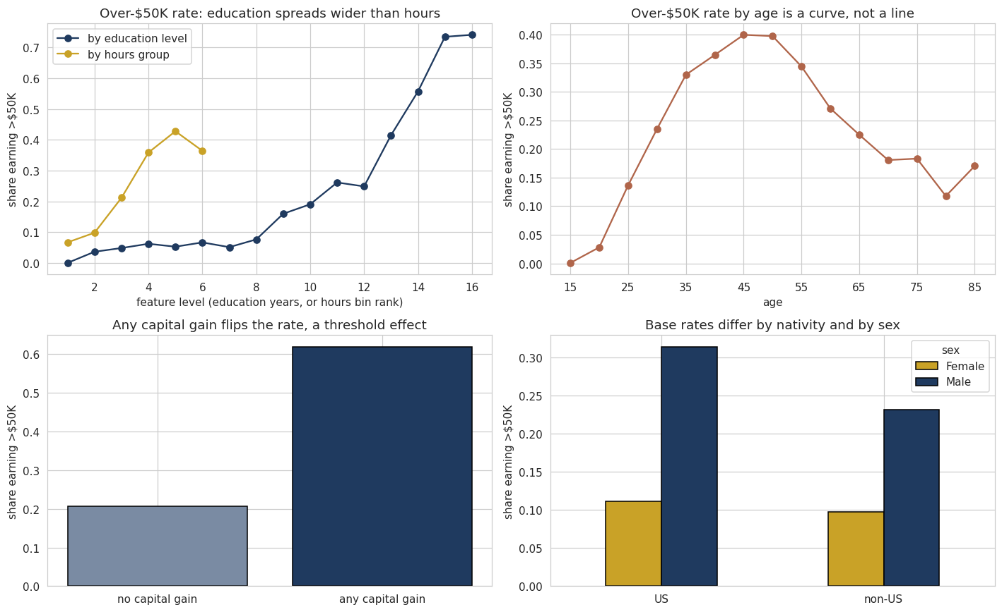
3
EDA findings the hypotheses rest on
Four findings carried forward from the EDA milestone, not the whole thing
WHAT EACH PANEL SHOWS
Education spreads wider than hours
Education moves the rate by about 0.74 from its lowest level to its highest, hours by about 0.36.
Age is a curve, not a line
It rises to about 45 and falls after.
A linear model cannot follow that without an age-squared term.
Any capital gain flips the rate
0.21 with none against 0.62 with any.
A threshold, which is why I added the binary flag.
Base rates already differ by group
24.6% of US-born earn over $50K against 18.7% of foreign-born
Men are higher inside both.
Part of any later gap starts in the data, not in the model.
Over-$50K rate by education and hours, by age, by capital gain, and by group.
Notes:
This slide is the EDA milestone compressed into the four findings the rest of the project depends on, so I am not repeating the whole thing. Top left is the H1 hint: education spreads the over-fifty-thousand rate by about 0.74 from its lowest level to its highest while hours spreads it by about 0.36, and education climbs steadily while hours flattens above full time. That is one feature at a time, so it is a hint and not a test, and the permutation importance later is the test. Top right and bottom left are the H3 reasoning, and I want to stress I stated it before seeing any model results. The rate by age is a curve a linear model cannot express without an age-squared term, and having any capital gain flips the rate from 0.21 to 0.62 instead of moving it gradually. Curves and thresholds are exactly what tree splits capture, which is why I expected XGBoost to win. Bottom right sets up H2: US-born people earn over fifty thousand at about 24.6 percent against 18.7 percent for foreign-born, and men are higher inside both groups. Those base-rate gaps are real and are what the models learn from, so a recall gap later cannot be blamed entirely on the model.

Slide 5
4
Feature engineering, and whether it earned its place
Four engineered features, each with a reason
native_region
has_capital_gain
has_capital_loss
hours_group
US · non-US · Unknown
binary flag
binary flag
6 ranges
Groups a 42-category column that is 90% US into the split H2 needs
Unknown kept separate
Almost always zero, with a few huge values
Flag is 1/0 for any capital gain
Keeps the dollar amount from dominating
Same reasoning
Gives the linear model a threshold it could not otherwise express
Over-$50K rate climbs with hours, then flattens
Binning lets the linear model follow that curve
Hypothesis 1 compares the features, not the encodings
BEFORE AND AFTER, ON THE VALIDATION SET ON DEFAULT LR
NO DIMENSIONALITY REDUCTION
Feature set | Columns | Recall | F1 | PR-AUC
Raw features only | 84 | 0.849 | 0.685 | 0.759
With engineered features | 52 | 0.850 | 0.689 | 0.773
PCA spread variance evenly
Only 7 numeric features, no strong multicollinearity
Hypothesis 1 needs the original features, which PCA would destroy
Engineered set wins on PR-AUC with 32 fewer columns
Dropped 39 near-empty native country dummies that contained a lot of noise
Notes:
Four engineered features, each with a reason and not added for the sake of it. The table on the bottom left is the part I want to point at. I fit the same default logistic regression on the raw feature set and on the engineered one, same split, and the engineered version wins on every metric while using 52 columns instead of 84. That turned an assumption into a measurement. On native_region specifically, the raw column has 42 categories and is 90 percent United States, so encoding it directly would have produced dozens of nearly empty columns. Grouping it gives the models a usable feature and creates the split my fairness audit needs. I did not use PCA, because H1 needs the original features.

Slide 6
5
The experimental pipeline
One pipeline shape for all three models, so any difference comes from the model
SQLite
load
Clean
Engineer
4 features
One-hot
52 cols
Stratified
60/20/20
Scale +
SMOTE
Fit
model
Tune on
validation
5-fold
paired CV
Test +
stat tests
SPLIT STRATEGY
CROSS-VALIDATION AND REPRODUCIBILITY
19,521 train / 6,508 validation / 6,508 test, stratified at 0.241
Train fits, validation tunes, test is touched once
How I confirm no leakage
Scaling and SMOTE sit inside the pipeline, refit every fold
SMOTE runs after the split, so no synthetic row reaches test
Every hyperparameter and threshold chosen on validation
5-fold stratified CV on the training rows
Fold indices generated once, reused for all three models
That is what makes the scores paired
Pairing is what gives a t-test power at n = 5
Each model builds its own StandardScaler
Pipelines do not copy their steps
Sharing one silently changed another model’s preprocessing
One random seed (42) throughout
Notes:
This is the whole pipeline in one row across the top. Two things are worth the time. First, the fold indices are generated once and handed to all three models, so every model sees the same five folds. That is what leaves them paired, and at five observations pairing is the difference between a test with some power and one with almost none. Second, the bug on the right. All three pipelines originally pointed at the same scaler object, and because scikit-learn pipelines do not copy their steps, refitting one model later changed the preprocessing of models I had already scored. XGBoost dropped from 0.805 to 0.744 with no error raised.
Stratified cross fold validation indices-row positions —> which rows go in which fold.

Slide 7
6
The three models, and how each makes a prediction
Plus the naive floor every one of them has to clear
Logistic regression
XGBoost
Multilayer perceptron
the interpretable baseline
gradient boosted trees
the neural network
A weighted sum of the features through a sigmoid, then a 0.5 threshold.
z = b₀ + Σ bⱼ xⱼ, p̂ = 1 / (1 + e⁻ᶻ)
One signed coefficient per feature, so it is fully readable.
Limit: linear and additive, so it misses interactions and curves. That limit is what Hypothesis 3 tests.
Builds shallow trees one at a time, each fit to the errors so far.
ŷ = σ( Σ η · f_k(x) )
Splits are chosen to most reduce a regularised objective.
Later trees split inside earlier regions, so it captures thresholds and interactions on its own.
Hidden layers of weighted sums with a non-linear activation.
h = ReLU(W₁x + b₁), p̂ = σ(W₂h + b₂)
Can represent interactions too, but with no structural head start.
So I expected it to need more rows.
THE NAIVE FLOOR
Labels everyone under $50K. Scores 0.759 accuracy while catching zero high earners, with PR-AUC at the 0.241 base rate. Accuracy in the high 70s means nothing here.
Notes:
Quick pass on the three models, because the guidelines ask how each one actually makes a prediction and not just its name. Logistic regression is a weighted sum through a sigmoid, fully readable, but linear and additive. XGBoost builds trees on the residuals, so it finds thresholds and interactions on its own. The MLP stacks non-linear layers, which can represent interactions too but has to learn them from scratch. One thing on why logistic regression is the baseline and not just something I want to beat: a lender has to explain a decision, and this model gives one signed coefficient per feature. So a small win by a more complex model has to be weighed against losing that. The bar at the bottom is the naive floor: 76 percent accuracy, zero high earners caught.

Slide 8
7
Evaluation metrics, and why each one is here
PR-AUC leads because it focuses on the positive class
THE FORMULAS
WHY PR-AUC IS THE LEAD METRIC
Accuracy = (TP + TN) / (TP + TN + FP + FN)
Precision = TP / (TP + FP) Recall = TP / (TP + FN)
F1 = 2 × (Precision × Recall) / (Precision + Recall)
PR-AUC = area under the precision-recall curve
ROC-AUC = area under the TPR vs FPR curve
Focuses on the positive class, no credit for the easy majority
No-skill floor is the 0.241 base rate, not 0.5
Threshold-free, so it compares ranking over all possible thresholds
ROC-AUC stays secondary: the easy negatives prop it up
WHAT EACH METRIC MEANS
Accuracy
Precision
Recall
F1
How often the model is right. Misleading under class imbalance.
Of those I call high earners, how many really are.
Of the real high earners, how many I catch.
Harmonic mean of the two, low unless both are decent.
Notes:
I define the metrics once because every table today reports the same ones. The thing to take away is why PR-AUC leads. It focuses on the positive class directly, it gets no credit for correctly rejecting the easy majority, its no-skill floor is the base rate instead of 0.5, and it is threshold-free so it compares ranking rather than where a cutoff lands. ROC-AUC stays in the tables but I keep it secondary, because on imbalanced data the big easy negative class props all three curves up and hides differences PR-AUC shows clearly. You will see that happen later. And the recall box at the bottom is the one that matters most: precision failures cost the lender review time, recall failures cost a person an opportunity, and the whole fairness audit is built on that second one.

Slide 9
8
The statistical toolkit, and why each test fits
A difference in numbers is not a finding until a test says it beats the noise
Paired t-test
Wilcoxon signed-rank
McNemar's exact test
Paired bootstrap CI
on 5 shared CV fold scores
on the same fold differences
on 6,508 shared test rows
1,000 resamples of the test set
Compares differences within each fold, not overall averages.
A hard or easy split cannot bias the comparison.
Used when you do not have a normal distribution: uses signs and ranks, not raw values.
Run alongside the t-test as a robustness check.
Compares predictions on the exact same rows, where the two models disagree.
Tests whether that disagreement splits 50/50.
All models scored on the same resamples, with the difference taken inside each.
Gives a CI directly on the difference.
ASSUMPTIONS
ASSUMPTIONS
ASSUMPTIONS
ASSUMPTIONS
Per-fold differences are normally distributed
Folds are independent of each other
Only needs the per-fold differences symmetric around the median
Little power at n = 5 since it can’ t produce p ≤ 0.05 with two-sided test, so it is a sanity check
Disagreements on one row are independent of any other row
Using an exact binomial method means the McNemar's test stays accurate even with very small datasets.
No distributional assumptions at all
Handles skewed or bounded metrics like PR-AUC and fairness gaps
Notes:
This is the slide my professor's feedback is really about. Claims about one model being better than another mean nothing without a test behind them, so here is what I used and why each one fits. The t-test and Wilcoxon work on the fold scores, and they only work because the folds are shared, which is the pairing requirement. McNemar is the right test for two classifiers on one shared test set, because their errors are paired at the row level. And the bootstrap is the workhorse, because it needs no distributional assumption and it lets me take the difference inside each resample, which is important: two overlapping confidence intervals do not actually mean a difference is non-significant, so comparing separate intervals by eye would be wrong.

Slide 10
9
Untuned models on the validation set
The before state, and the baseline
LIBRARY DEFAULTS, SAME PIPELINE, SAME VALIDATION ROWS
Model | Accuracy | Precision | Recall | F1 | PR-AUC | ROC-AUC
Naive (majority class) | 0.759 | 0.000 | 0.000 | 0.000 | 0.241 | 0.500
LR, raw imbalance | 0.848 | 0.722 | 0.603 | 0.657 | 0.771 | 0.909
LR + SMOTE (the baseline) | 0.815 | 0.580 | 0.850 | 0.689 | 0.773 | 0.909
XGBoost | 0.856 | 0.690 | 0.730 | 0.709 | 0.809 | 0.922
MLP | 0.819 | 0.594 | 0.793 | 0.679 | 0.744 | 0.893
SMOTE DOES WHAT I WANTED
XGBOOST ALREADY LEADS
MLP BELOW THE BASELINE
Recall goes from 0.603 to 0.850, paid for in precision for LR due to more false positives.
The right trade for a lender that would rather review a borderline case.
0.809 PR-AUC against 0.773 for the baseline, untuned.
It trades recall for precision, which is where its higher F1 comes from.
0.744 PR-AUC, under the logistic regression’s 0.773.
First sign the dataset is too small for the neural network.
Notes:
Every model with library defaults on the validation set. Three things. One, SMOTE lifts recall from 0.60 to 0.85 on the logistic regression. Notice accuracy actually falls, from 0.848 to 0.815, so optimizing accuracy would have meant dropping SMOTE and building a worse model for this use case. Two, XGBoost already leads on PR-AUC and F1 before I tune anything. Three, the untuned MLP lands below the logistic baseline, which is the first evidence for half of my H3 reasoning. To be clear on the baseline, it is the untuned logistic regression with SMOTE, the middle row. Nothing is settled yet, these are validation numbers with no tests behind them.

Slide 11
10
Hyperparameter tuning
Grid search: fit on train, score on validation, keep the best. The test set is not involved
WHAT EACH KNOB CONTROLS AND WHY IT MATTERS
CHOSEN VALUES, JUSTIFIED WITH BEFORE AND AFTER
LR · C {0.01, 0.1, 1, 10}
Inverse regularization strength. Small underfits, large overfits.
LR · penalty {L1, L2}
L2 shrinks coefficients towards 0, L1 can zero them out.
XGB · max_depth {3, 5, 7}
Tree depth. Deeper expresses more interactions, memorizes noise.
XGB · learning_rate {0.05, 0.1} · n_estimators {200, 400}
Contribution per tree on final model, and how many trees. These trade off.
MLP · hidden_layer_sizes {(50), (100), (64,32)} · alpha {0.0001, 0.01}
Capacity (model complexity) and weight penalty. More capacity needs more data.
Model | Chosen values | Untuned | Tuned | Δ
LR | C=10, L1 | 0.7728 | 0.7737 | +0.0009
XGBoost | depth 7, lr 0.05, 400 trees, subsample 0.8 | 0.8091 | 0.8110 | +0.0019
MLP | (50,), alpha 0.01 | 0.7435 | 0.7747 | +0.0311
Validation PR-AUC before and after tuning. 26 settings swept in total.
WHY THE THREE NUMBERS DIFFER SO MUCH
Logistic regression barely moves
XGBoost barely moves either
The MLP needed tuning most
Already flat by C = 1. It was near its ceiling before I started.
Default hyperparameter values are already sensible for tabular data this size.
The smallest network with the strongest penalty won. It lacks data for its capacity.
Notes:
Left side is what each parameter actually controls, which the guidelines ask for. Right side is the before and after that justifies each choice. But the interesting part is the bottom bar. The logistic regression gains nine ten-thousandths, XGBoost gains nineteen, and the MLP gains three hundred and eleven. The logistic regression barely moves because it was already at its ceiling, which I showed with a validation curve last milestone. XGBoost barely moves because its defaults are already good for this kind of data. The MLP is the one that really needed it, and the direction it moved matters: the smallest network with the strongest regularisation won. A model that gets better when you shrink it is telling you it does not have enough data for its capacity.
Weight Penalty Hyperparameter for MLP model: regularization hyperparameter that adds a penalty proportional to the size of the network's weights to the loss function
-prevents overfitting by forcing the model to keep weights small (and creates more smoother and general decision boundaries)
-can use L1 or L2 regularization weight penalties
Too High (α > 0): The model becomes overly constrained, leading to high bias and underfitting
Too Low (α → 0): The network ignores the penalty, risking high variance and overfitting to the training set.
Subsample hyperparameter for xgboost: controls the fraction of the training data rows used to build each tree
Value of 1: all training data rows used for each tree
Value of .5: uses 50% of training data rows for each tree being built

Slide 12
11
Cross-validation on identical folds
Mean, standard deviation, and variance across five stratified folds
ALL THREE MODELS SCORED ON THE SAME FIVE FOLDS
Model | PR-AUC mean | PR-AUC std | PR-AUC var | F1 mean | F1 std | Recall mean | Accuracy mean
Logistic regression | 0.7797 | 0.0105 | 0.0001 | 0.6876 | 0.0109 | 0.8371 | 0.8168
MLP | 0.7878 | 0.0143 | 0.0002 | 0.6905 | 0.0102 | 0.8348 | 0.8197
XGBoost | 0.8186 | 0.0114 | 0.0001 | 0.7198 | 0.0101 | 0.7385 | 0.8615
WHAT THE SPREAD TELLS ME
95% CI ON CROSS-VALIDATED PR-AUC
Standard deviations near 0.01, so no model rides on a lucky split
Variance is small next to the 0.039 PR-AUC gap between XGBoost and the baseline
XGBoost leads everywhere but recall: where it acts more conservatively
So the models are not compared at the same recall later due to different spread of probabilities for each model for high earners
Model | Mean | 95% CI | Width
LR | 0.7797 | 0.7667 – 0.7927 | 0.0260
MLP | 0.7878 | 0.7701 – 0.8055 | 0.0354
XGBoost | 0.8186 | 0.8044 – 0.8328 | 0.0284
Built from five fold scores, so wider than the bootstrap intervals later.
Notes:
Five stratified folds on the training rows, same folds for all three models. Standard deviations around 0.01 everywhere, so these are stable and not lucky. XGBoost leads on PR-AUC, F1, and accuracy. But look at the recall column: XGBoost is lowest at 0.74 while the other two are at 0.84. It is trading caught high earners for far fewer false alarms, and that comes back in the fairness section. The variance column is worth a look, since the guidelines ask for it. Every model comes in at one to two ten-thousandths, small next to the 0.039 gap between XGBoost and the baseline. That ratio is why the tests on the next slide have any chance of working. One procedural note: this runs on the training rows only. It is a stability check, and the test set is still untouched.

Slide 13
12
Paired tests on the same five folds
Both tests run on the per-fold differences
PAIRED T-TEST AND WILCOXON SIGNED-RANK
WHY EVERY WILCOXON P IS 0.0625
Metric | Comparison | Mean diff | t | t p-value | Wilcoxon p
PR-AUC | XGBoost vs LR | 0.0389 | 12.99 | 0.0002 | 0.0625
PR-AUC | XGBoost vs MLP | 0.0308 | 7.72 | 0.0015 | 0.0625
PR-AUC | MLP vs LR | 0.0081 | 4.34 | 0.0123 | 0.0625
F1 | XGBoost vs LR | 0.0322 | 7.12 | 0.0021 | 0.0625
F1 | XGBoost vs MLP | 0.0293 | 10.51 | 0.0005 | 0.0625
F1 | MLP vs LR | 0.0028 | 1.41 | 0.2317 | 0.1875
Wilcoxon counts which model won each fold, not by how much
Winning all 5 folds is the most lopsided result possible: p = 0.0625
So 0.0625 is its floor at n = 5, not weak evidence
MLP won 4 of 5 folds on F1, giving p = 0.1875
The 0.0625 says XGBoost won all five folds.
Every PR-AUC comparison is significant. On F1, both XGBoost comparisons are, and MLP against the baseline is not, at p = 0.23.
Notes:
On PR-AUC every comparison clears 0.05 by the paired t-test. On F1 the two XGBoost comparisons clear it and the MLP against logistic regression does not. Now, the Wilcoxon column. Every significant row comes back at exactly 0.0625 and that is not a coincidence I should read as weak evidence. With five paired observations there are only thirty-two possible sign patterns, so the most extreme one still leaves one sixteenth of the probability in the tails. The test literally cannot go below 0.05 at this sample size. What it does tell me is that XGBoost won on all five folds with no exceptions. This is why I do not stop at fold tests, and why the next two slides use all 6,508 test rows instead.

Slide 14
13
Confidence level, interval width, and sample size
The same difference, the same five folds, three confidence levels
CI ON THE XGBOOST MINUS LR PR-AUC DIFFERENCE
WHAT COUNTS AS A GOOD INTERVAL
Level | Interval | Width | Excludes 0
90% | 0.0325 – 0.0453 | 0.0128 | yes
95% | 0.0306 – 0.0472 | 0.0166 | yes
99% | 0.0251 – 0.0527 | 0.0276 | yes
A narrow interval at low confidence is bought by lowering the bar
What I want is narrow at high confidence
Only more data gives both, and width shrinks with √n
An interval containing zero means the difference between the models is not statistically significant
Higher confidence means a wider net. The data did not change.
WHERE MORE DATA HELPS ME
Five fold scores on 19,521 training rows
6,508 test rows resampled 1000 times (bootstrap)
95% CI on cross-validated PR-AUC, from five numbers:
LR 0.0260 wide · MLP 0.0354 wide · XGBoost 0.0284 wide
Per-model intervals are wide because I estimate them from five numbers
95% CI on the difference, from every test row:
XGBoost advantage over LR: 0.0218 to 0.0402, only 0.0184 wide
Interval on the gap is narrow because pairing cancels the noise the two models share
Notes:
This slide is directly about the note on confidence intervals. Same difference, same five folds, three confidence levels. The 90 percent interval is narrowest and the 99 percent is widest, and nothing about the data changed between those rows. So a narrow interval only means something if it is narrow at a high confidence level, and the only way to get both is more data. The bottom bar shows that working in my favour: the fold-based intervals rest on five numbers and run 0.026 to 0.035 wide, while the bootstrap interval on the difference uses all 6,508 test rows and is 0.018 wide at the same 95 percent level. In a couple of slides you will see the same principle working against me, on the fairness gap.

Slide 15
14
Final results on the held-out test set
Touched once, at the end. Every tuning decision was made on validation
ALL MODELS AGAINST THE NAIVE FLOOR AND THE UNTUNED BASELINE
Model | Accuracy | Precision | Recall | F1 | PR-AUC | ROC-AUC
Naive (majority class) | 0.759 | 0.000 | 0.000 | 0.000 | 0.241 | 0.500
LR untuned (the baseline) | 0.816 | 0.585 | 0.818 | 0.682 | 0.773 | 0.904
LR tuned | 0.818 | 0.587 | 0.820 | 0.684 | 0.774 | 0.904
MLP tuned | 0.825 | 0.604 | 0.789 | 0.684 | 0.775 | 0.903
XGBoost tuned | 0.857 | 0.695 | 0.721 | 0.708 | 0.805 | 0.915
THE ORDERING HELD
BUT LOOK AT RECALL
WHY THAT MATTERS NEXT
XGBoost led on validation and on test, so the tuning did not overfit.
Tuned LR barely moves from untuned, 0.774 against 0.773.
XGBoost has the highest F1 and the lowest recall, 0.721 against 0.820.
It trades catches for far fewer false alarms, 495 against 905.
The three models are not at the same operating point.
So their fairness gaps are measured at different recall levels due to different probabilities for each model at the 0.5 threshold. I return to this in Hypothesis 2.
Notes:
The test set, touched once. XGBoost reaches 0.805 PR-AUC and 0.708 F1 against 0.774 and 0.684 for the tuned logistic regression, so it clears the baseline on both metrics H3 names. The ordering from validation held, which matters because a model that led on validation and collapsed on test would mean I had overfit my tuning. Look at the naive row while we are here: 0.759 accuracy, higher than the logistic regression manages, and it catches zero high earners. That is the clearest justification for everything I said about metric choice. One thing I want to plant now: XGBoost has the highest F1 and the lowest recall of the three. It catches fewer high earners but nearly halves the false alarms, so the three models are not sitting at the same operating point. That comes back when I compare their fairness gaps.

Slide 16
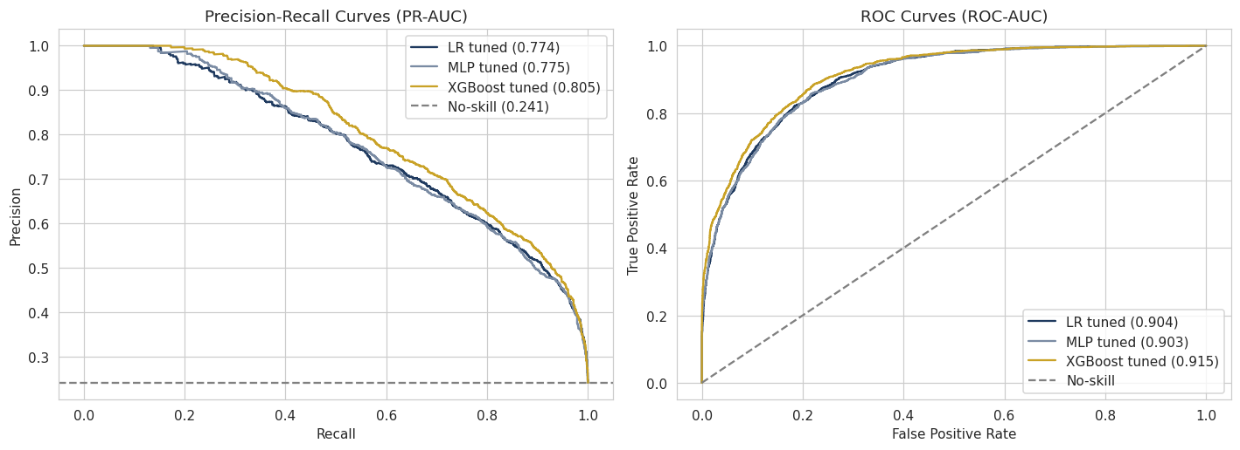
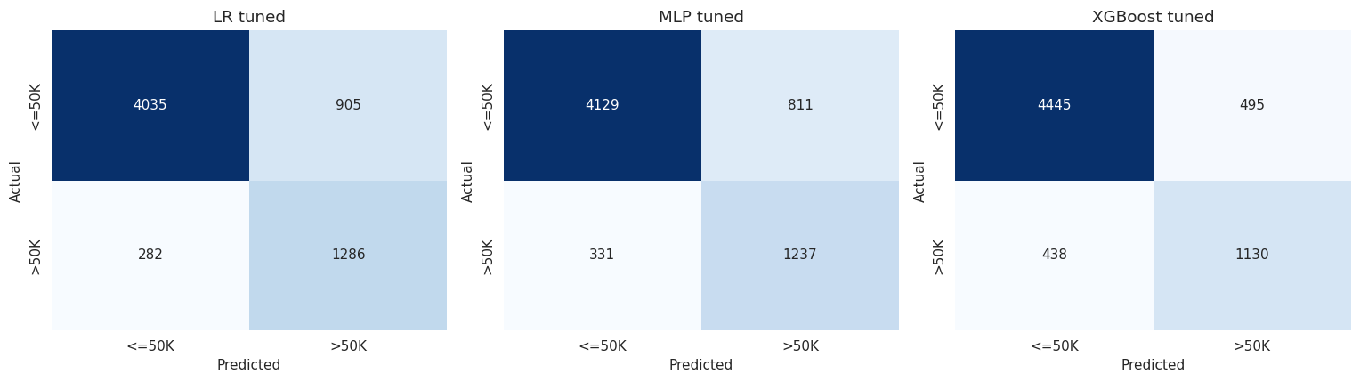
15
Precision-recall and ROC curves
The plot that shows the difference, next to the plot that hides it
WHAT THESE SHOW
XGBoost sits above the other two across nearly the whole recall range
All three clear the 0.241 no-skill line, so all three have real signal
The ROC curves nearly overlap: the easy negatives prop them up
That is why PR-AUC leads and ROC-AUC does not
Confusion matrices: LR catches the most high earners but pays with 905 false alarms. XGBoost trades some catches for far fewer.
Notes:
Left top is the precision-recall curve and it is the plot that matters. XGBoost sits above the other two across nearly the whole recall range, meaning at whatever recall I choose to operate at, it flags fewer people wrongly. All three stay well above the no-skill line so all three have real signal. Now compare that with the ROC curves on the right of that image: they are almost on top of each other. That is exactly the flattering behaviour I warned about, the large easy negative class propping all three curves up and hiding a gap that PR-AUC shows clearly. Bottom row is the confusion matrices, showing the same trade in counts.

Slide 17
16
Bootstrap intervals and McNemar's test
1,000 paired resamples, and the 6,508 rows every model predicted on
PAIRED BOOTSTRAP CI ON THE DIFFERENCE BETWEEN MODELS
MCNEMAR'S EXACT TEST, DISCORDANT ROWS ONLY
Metric | Comparison | Diff | 95% CI | Excl. 0 | Win rate
PR-AUC | XGB − LR | 0.0309 | 0.0218 – 0.0402 | yes | 100%
PR-AUC | XGB − MLP | 0.0302 | 0.0221 – 0.0378 | yes | 100%
PR-AUC | MLP − LR | 0.0007 | −0.0071 – 0.0090 | no | 58%
F1 | XGB − LR | 0.0238 | 0.0101 – 0.0368 | yes | 100%
F1 | XGB − MLP | 0.0240 | 0.0123 – 0.0367 | yes | 100%
F1 | MLP − LR | −0.0002 | −0.0103 – 0.0105 | no | 48%
Comparison | First only | Second only | p-value
XGBoost vs LR | 454 | 200 | 1.2e−23
XGBoost vs MLP | 373 | 164 | 9.6e−20
MLP vs LR | 272 | 227 | 0.049
Rows only the first got right, against rows only the second got right.
WHERE THE FOUR TESTS AGREE
WHERE THEY DISAGREE, AND WHAT I DID
XGBoost vs LR on PR-AUC: t-test p = 0.0002
Bootstrap CI from 0.022 to 0.040 excluding zero
XGBoost ahead in 1000 of 1000 resamples
McNemar p = 1.2e−23
Four methods with different assumptions, all agreeing.
Where XGBoost disagrees with LR or MLP, it is the one that is right about 70% of the time
MLP vs LR: both significant results are borderline, McNemar at 0.049
The bootstrap interval runs −0.007 to +0.009, including zero
I trust the bootstrap: the MLP bought nothing over a linear model
Notes:
Left is the bootstrap, and the intervals are on the difference, taken inside each resample, not two separate intervals compared by eye. For XGBoost against either model the interval excludes zero and it won a thousand out of a thousand resamples. Right is McNemar: 454 rows XGBoost fixed against 200 it broke, p on the order of ten to the minus twenty-three. Where the tests disagree is the MLP against the logistic regression, and I want to be honest about that: fold t-test significant, McNemar 0.049, bootstrap contains zero. I go with the bootstrap, because it has the most data and fewest assumptions. The neural network bought nothing over a linear model here.

Slide 18
Hypothesis 3 verdict: supported
SUPPORTED
XGBoost beats the logistic baseline and the MLP on PR-AUC and F1
THE EVIDENCE
BOTH HALVES OF THE REASONING HELD
Test set: 0.805 PR-AUC and 0.708 F1, against 0.774 for LR and 0.775 for MLP PR-AUC, 0.684 F1 for both
Paired t-test on PR-AUC: p = 0.0002 vs LR, p = 0.0015 vs MLP
Paired bootstrap on PR-AUC vs LR: 0.022 to 0.040, excluding zero, 1000 of 1000
McNemar: p = 1.2e−23 vs LR, 9.6e−20 vs MLP
XGBoost led on all five folds
Non-linear structure was real
Age curves, capital-gain thresholds, and education-by-marital-status interactions
The dataset was too small for the MLP
It improved when I shrank it to one 50-neuron layer
WHAT I WOULD NOT CLAIM
THE COST SIDE OF THE VERDICT
The MLP beating logistic regression. That bootstrap interval contains zero, so the neural network bought no significant gain over a linear model.
A finding, not a failure, and the second half of my Hypothesis 3 reasoning.
Compute is not the issue:
Fit time: a few seconds per model, MLP slowest
All three predict on 6,508 rows in under 0.1s
The real cost is interpretability. LR gives one signed coefficient per feature. XGBoost has 400 trees and needs a surrogate to explain at all.
Notes:
H3 is supported and it is the best evidenced result in the project. Four separate readings agree and XGBoost led on every fold. I want to stress that I stated the reasoning before seeing results, and both halves of it held: the non-linear structure was real, and the dataset really was too small for the neural network, which showed up in the MLP getting better when I made it smaller. The part of H3 I will not claim is the MLP beating the logistic regression, because the bootstrap interval on that difference contains zero. And the verdict includes the cost: compute is cheap, but XGBoost gives up the transparency that matters for a lending decision somebody can be asked to explain.
Surrogate model in Machine Learning: a simpler model type sharing a similar structure to help you improve the complex model's explainability

Slide 19
17
Fairness audit: performance split by group
Recall on real high earners, the error that hurts the applicant
THE TWO GROUP IMBALANCES
WHY RECALL AND NOT ACCURACY
Group | Test rows | Share | >50K rate | High earners
US-born | 5,819 | 89.4% | 0.247 | 1,436
Foreign-born | 576 | 8.9% | 0.172 | 99
Male | 4,335 | 66.6% | 0.306 | 1,327
Female | 2,173 | 33.4% | 0.111 | 241
A missed high earner qualifies but is not flagged in a case such as lending
More misses in one group means worse service for that group
Group accuracy is misleading
Every model looks more accurate on women and on the foreign-born group
Minority groups have fewer high earners, so predicting under $50K is right more often
RECALL AND ACCURACY BY NATIVITY
RECALL AND ACCURACY BY SEX
Model | Recall US | Recall non-US | Recall gap | Acc US | Acc non-US
LR tuned | 0.823 | 0.768 | 0.055 | 0.816 | 0.844
MLP tuned | 0.793 | 0.747 | 0.046 | 0.823 | 0.851
XGBoost tuned | 0.726 | 0.646 | 0.079 | 0.855 | 0.882
Model | Recall Male | Recall Female | Recall gap | Acc Male | Acc Female
LR tuned | 0.836 | 0.730 | 0.106 | 0.766 | 0.920
MLP tuned | 0.806 | 0.697 | 0.108 | 0.775 | 0.924
XGBoost tuned | 0.743 | 0.598 | 0.146 | 0.818 | 0.935
Hypothesis 2 predicted XGBoost would have the smallest gap. It has the largest.
Same ordering, larger gaps. Every model finds male high earners more reliably.
Notes:
Here is the audit. Foreign-born people are 9 percent of the data and women are 33 percent. I audit on recall for real high earners, not accuracy, and the reason is on the right. Every model looks more accurate on women, which would read as serving them better. It is not. Women have fewer high earners, so predicting under fifty thousand is right more often. Recall shows what is happening: every model misses more female high earners, by ten to fifteen points, and on both axes XGBoost has the largest gap, the opposite of what H2 predicted. Part of that gap is inherited though. The base rates differ, 24.6 against 18.7 percent, so H2 really asks which model handles the pre-existing gap best.

Slide 20
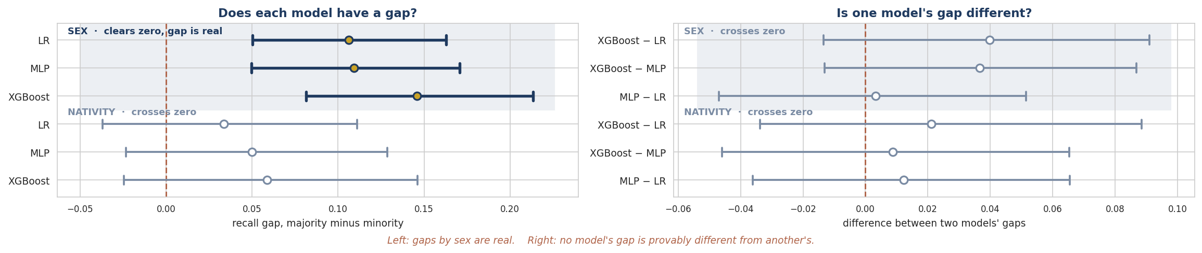
18
Putting intervals on the gaps
This is where the sample size problem becomes the finding
BOOTSTRAP 95% CI ON EACH MODEL'S RECALL GAP
HOW MUCH MORE DATA WOULD SETTLE IT
Gap | Model | Estimate | 95% CI | Real?
US − non-US | LR | 0.034 | −0.037 – 0.111 | no
US − non-US | MLP | 0.050 | −0.023 – 0.129 | no
US − non-US | XGBoost | 0.059 | −0.025 – 0.146 | no
Male − Female | LR | 0.106 | 0.050 – 0.163 | yes
Male − Female | MLP | 0.109 | 0.050 – 0.171 | yes
Male − Female | XGBoost | 0.146 | 0.081 – 0.213 | yes
The nativity gap rests on 99 foreign-born high earners. The interval spans 0.171.
Target CI width | Multiple needed | High earners needed
0.05 | 11.6× | 1,153
0.02 | 72.8× | 7,208
No model has a statistically significant nativity recall gap
Every model has a statistically significant sex recall gap
Wide because the non-US group is small, not because the models are unstable.
HYPOTHESIS 2, SET AGAINST WHAT THE INTERVALS CAN SHOW
What I predicted
XGBoost would have the smallest nativity recall gap.
What I found
It has the largest: 0.079 against 0.055 for LR and 0.046 for MLP. Refuted.
What I cannot claim
That any model is really fairer. No difference clears zero.
Notes:
Bottom box lines H2 up against what I can actually show. I predicted XGBoost would have the smallest nativity gap. It has the largest, 0.079 against 0.055 and 0.046, so the direction is the opposite of my prediction and H2 is refuted. But I want to be careful about the second half. I also cannot claim any model is really fairer than another, because every interval on a difference between two models' gaps contains zero. The chart shows why. Top block is sex, where every interval clears zero, so those gaps are real. Bottom block is nativity, where every interval crosses zero. And the grey bars are about three times longer than the navy ones, because they rest on 99 foreign-born high earners instead of 241 women. Same method, less data, no resolution.

Slide 21
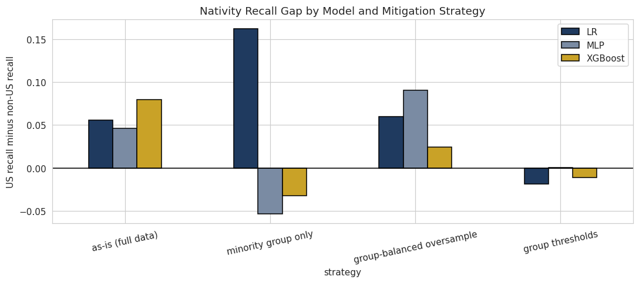
19
Handling the group imbalance
Finding a gap is half the job. Closing it and pricing that is the other half
FOUR STRATEGIES, AND WHAT EACH ONE SHOWED
Train on the minority group only
Only 1,680 training rows
The female-only XGBoost drops to 0.375 recall on men
It moved who gets served badly.
Group-balanced oversampling
Duplicate minority rows until balanced
XGBoost nativity recall gap drops from 0.079 to 0.024, for 0.005 decline of F1
XGBoost sex recall gap drops from 0.146 to 0.099, for 0.002 decline of F1.
Group-specific thresholds
A different probability cutoff per group, 0.43 US-born and 0.32 foreign-born
XGBoost nativity recall gap drops from 0.079 to −0.011, for 0.012 drop of F1
XGBoost's cutoffs are 0.45 for men and 0.24 for women
XGBoost sex recall gap drops from 0.146 to −0.023, for 0.007 drop of F1
Nativity recall gap by model and strategy. Lower is fairer, zero is parity.
WHAT I WOULD ACTUALLY DEPLOY
Group thresholds work best, but they use nativity or sex to decide an outcome, which is very likely illegal in lending.
So I would deploy group-balanced oversampling.
Notes:
Three ways of trying to close the gap plus the as-is model. Training on the minority group only is the worst, and it failed in a useful way: the female-only XGBoost drops to 0.375 recall on men. Cutting the data to the group did not fix the gap, it just moved who gets served badly, which answers the question that experiment was designed to ask. Group-balanced oversampling cuts XGBoost's nativity gap from 0.079 to 0.024 for about two thousandths of F1. Group thresholds work best of all, but I would not deploy them, because a threshold that depends on nativity or sex is very likely illegal under fair lending rules no matter how good the intent. So my recommendation is the oversampling, and the thresholds are a diagnostic.

Slide 22
H2 verdict: refuted
REFUTED
XGBoost does not have the smallest US-born vs foreign-born recall gap
THE POINT ESTIMATES GO THE OTHER WAY
THE MORE CAREFUL STATEMENT
Largest raw nativity recall gap at 0.079, against 0.055 for LR and 0.046 for MLP
Same ordering on sex recall gap: 0.146 for XGBoost against 0.106 for LR and 0.108 for MLP
The hypothesis predicted the opposite direction
No model is statistically distinguishable from any other on the nativity recall gap
Every interval on a difference contains zero, fold tests give p = 0.13 to 0.99
99 foreign-born high earners cannot resolve differences this small between models
A CONFOUND I HAVE TO NAME
WHAT IS SETTLED
The models sit at different recall levels, 0.72 for XGBoost against 0.82 for LR.
At matched thresholds, about 0.78 recall, its gap becomes −0.011 and it still has the highest F1.
So part of the raw gap is where its threshold lands.
All three models miss female high earners by 11 to 15 points more, every interval excluding zero.
Base rates differ too, 24.6% US-born against 18.7% non-US born, so some gap is inherited from the data.
Notes:
H2 is refuted. XGBoost has the largest gap, not the smallest, on both group axes. But I want to be careful about how strongly I say that, because the more accurate statement is that no model is distinguishable from any other here. Every interval on a difference contains zero. So the hypothesis is not supported and the reverse is not supported either. I also have to name a confound instead of hiding it: the three models sit at different recall levels, so their gaps are not measured at the same operating point. When the group thresholds put all three at about 0.78 recall, XGBoost's nativity gap goes to essentially zero and it still has the best F1. What is genuinely settled is the sex gap, which is real for every model.

Slide 23
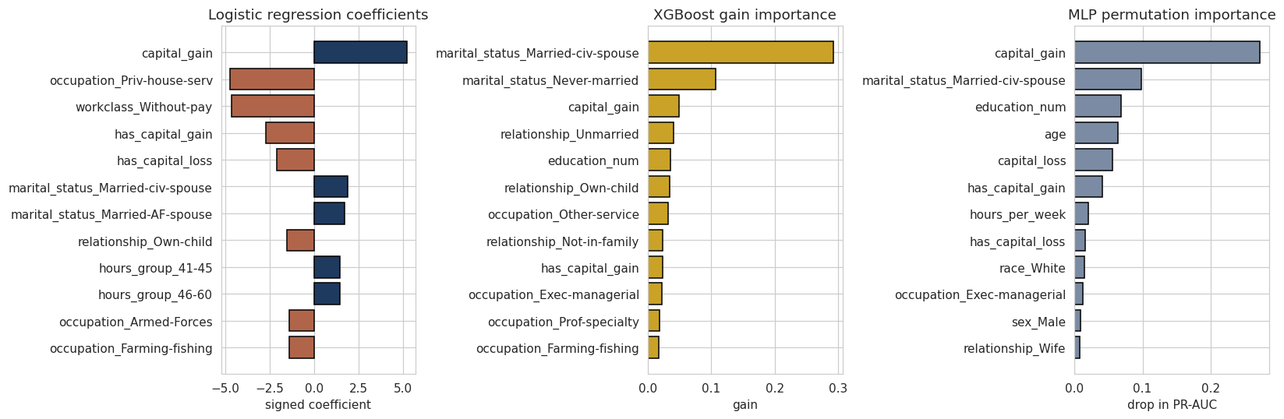
H1 verdict: supported
SUPPORTED
Education drives the over-$50K prediction more than hours worked, on all three models
PERMUTATION IMPORTANCE ON PR-AUC, TEST SET, 20 REPEATS EACH
ONE METHODOLOGICAL DETAIL
Model | Edu. drop | Hrs drop | Diff | 95% CI | Wins
Logistic regression | 0.0729 | 0.0288 | 0.0441 | 0.0415 – 0.0467 | yes
XGBoost | 0.0588 | 0.0196 | 0.0392 | 0.0374 – 0.0411 | yes
MLP | 0.0692 | 0.0251 | 0.0441 | 0.0415 – 0.0467 | yes
Education is one column, education_num. Hours is six: hours_per_week plus five bin dummy variables.
Shuffling just one of them leaves the other five still carrying hours, so hours would look useless.
So I shuffle all six together, moving each row's hours values as a unit.
Education is worth 2.5 to 3× as much as hours to every model, all intervals excluding zero.
WHAT HYPOTHESIS 1 DOES NOT CLAIM
It does not claim education is the top feature overall. Capital gain and marital status outrank it.
Hypothesis 1 is about education against hours specifically.
Three EDA methods already said this: rate spread, a decision tree, and Cohen's d. This is the fourth to say the same.
Each model with its own native importance measure: signed coefficients, gain, and permutation drop in PR-AUC.
*Cohen’s d: the difference between two group means, in standard deviations
Notes:
H1 is supported on all three models, and the agreement across models is what makes it convincing instead of a quirk of one algorithm. Education is worth two and a half to three times as much as hours to every model, and all three intervals exclude zero by a wide margin. One methodological detail I want to flag, top right: education lives in one column but hours lives in hours_per_week plus the six hours_group dummies I engineered. Shuffling only the raw column would leave the dummies telling the model the answer, so I shuffle the whole hours block together. That gives hours a fair shot instead of handicapping it. And what H1 does not claim: education is not the top feature overall, capital gain and marital status outrank it. H1 is about education against hours specifically.

Slide 24
20
Error analysis: who each model gets wrong
And whether XGBoost’s advantage comes from fixing the baseline’s weakness
ERROR COUNTS AND THE MISSED-EARNER PROFILE
WHERE XGBOOST'S ADVANTAGE ACTUALLY LIVES
Model | Missed >50K | Caught | False alarms | Missed with $0 cap. gain
LR tuned | 282 | 1,286 | 905 | 94.7%
MLP tuned | 331 | 1,237 | 811 | 93.4%
XGBoost tuned | 438 | 1,130 | 495 | 96.6%
On the 654 rows where XGBoost and LR disagree, XGBoost is right on 454
Those wins average $460 of capital gain, against $254 on the 200 it loses
Capital gain acts as a threshold rather than a slope, which is where the models differ
XGBoost can split again inside a capital-gain region.
LR gives it one coefficient for everybody.
The high earners every model misses look ordinary: almost no capital gain, younger, less educated.
RECALL BY SUBGROUP: EVERY MODEL FAILS ON THE SAME KIND OF PERSON
Subgroup | Rows | True >50K rate | LR recall | MLP recall | XGBoost recall
Education ≤ 9 years | 2,946 | 0.133 | 0.647 | 0.578 | 0.488
Education 10–12 years | 1,931 | 0.199 | 0.795 | 0.761 | 0.668
Education 13+ years | 1,631 | 0.486 | 0.918 | 0.907 | 0.861
Age 17–30 | 2,038 | 0.069 | 0.603 | 0.475 | 0.433
Age 60+ | 491 | 0.238 | 0.897 | 0.701 | 0.607
Notes:
The pattern from the baseline milestone holds for all three models: the high earners they miss look ordinary on the strongest features, with about 95 percent having zero capital gain. XGBoost misses more in total because of its lower recall, but it nearly halves the false alarms, from 905 to 495. The disagreement analysis on the right is where its advantage lives: on the 654 rows where the two models disagree, XGBoost is right on 454, and the rows it fixes have twice the capital gain of the rows it breaks. Bottom table: every model fails on the same kind of person, low education and young. The exception is the over-60 band, only 491 rows, where the logistic regression beats XGBoost 0.897 to 0.607.

Slide 25
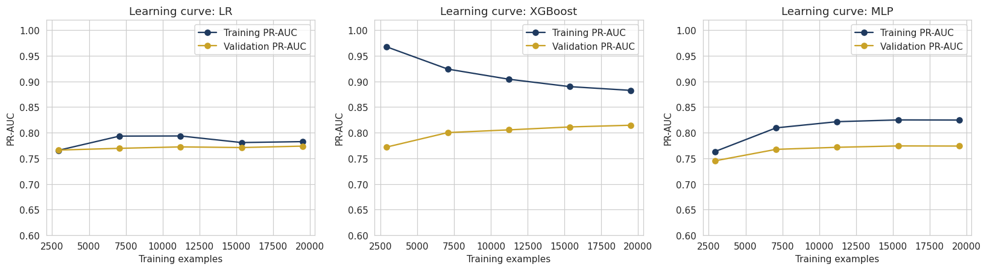
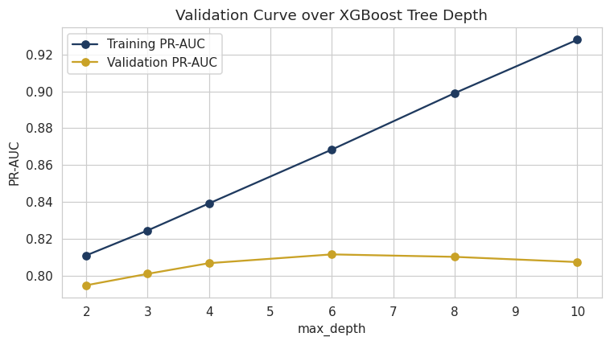
21
Overfitting, underfitting, and generalization
Two plots, two different questions
WHAT SEPARATES THEM
Logistic regression
Low variance between training and validation sets. The model has hit its ceiling.
XGBoost
Gap narrows from 0.19 to 0.07 with more rows, but never closes. Still the highest validation score of any model.
MLP
Starts lowest, flattens where LR lands. Capable of non-linear structure, but 19,521 rows was not enough to learn it.
Verdict
XGBoost does overfit as tree depth increases, but its win shows up on held-out rows and on every fold
Learning curves ask whether more rows would help. All three flatten early.
The validation curve asks whether the model fits too hard.
Training keeps climbing with depth while validation flattens. The tuned depth of 7 sits at that peak.
Notes:
Two plots answering two different questions. The learning curves on top ask whether more rows would help, and all three flatten after a few thousand rows, so none is starved in the ordinary sense. What separates them is the gap between the training and validation lines. The logistic regression's two lines are almost on top of each other, which is a low variance model underfitting if anything. XGBoost shows a clear persistent gap, which is what a 400-tree depth-7 ensemble does. That is not a problem in itself because its validation score is still the highest. The validation curve bottom left is the cleaner picture: training keeps climbing with depth while validation peaks and flattens, and my tuned depth of 7 sits right at that peak.

Slide 26
22
Strengths and limitations
What the methodology did well, and where it specifically falls short
STRENGTHS
LIMITATIONS
Every comparison is backed by a test with an interval
Where the tests disagreed, I reported the disagreement
The cross-validation is properly paired
All three models saw the same five folds
Leakage is structurally difficult
Scaler and SMOTE refit inside every fold, and each model has its own
The fairness work goes past reporting a gap
Measured it, put a CI on it, tested three fixes, and checked each one in F1 drop
The hypotheses could be refuted, and one was
Stated with their reasoning before I saw any results
The nativity comparison is underpowered and I could not fix it
99 foreign-born high earners makes the interval too wide to be useful
Grid search on one validation split, not nested CV
Best of 26 hyperparameter settings on one fixed set of rows, so the winning validation score is optimistic
The models are compared at the default 0.5 threshold
They sit at different recall levels, so each model's gap is measured at its own operating point
No calibration analysis
All three models overpredict, averaging 0.27 to 0.35 for mean predicted probability against a true rate of 0.241, because SMOTE balanced the training data
SMOTE on one-hot columns is questionable
SMOTE blends rows together as weighted average without knowing one-hot columns belong together, so a category can land at 0.4
Notes:
Strengths on the left. The one I would emphasise is that where the tests disagreed I said so instead of picking the test that gave the answer I wanted, and that one of my hypotheses got refuted, which is the sign the setup was honest and not built to confirm what I expected. Limitations on the right, and the first one is the real one: the nativity comparison is underpowered and no amount of modelling would have fixed it. The others are things I would do next: nested cross-validation instead of a single validation split, comparison at a matched threshold, and calibration, which matters because a lender needs probabilities that mean what they say and not just probabilities that rank correctly.
SMOTE interpolates (it takes a weighted average of a minority row and a neighbor, one random weight applied to the whole row. The one-hot block still sums to one, so it reads as a soft membership rather than a broken row, and both the linear models and the trees handle it coherently) between a minority group row and one of its nearest neighbors, and it runs after one-hot encoding, so it has no idea which columns belong together. If the base row is Sales and the neighbor is Exec-managerial, the synthetic row comes out 0.6 Sales and 0.4 Exec. It only affects training folds, never validation or test, so no result I am reporting is measured on synthetic data.

Slide 27
23
Bias and broader societal impact
Who is affected if this is deployed, and how it could cause harm
BIASES IN THE DATA, THE LABEL, AND THE SAMPLING
IF THIS WERE DEPLOYED
The data is a 1994 census extract
It inherits that period’s wage and education gaps, and is three decades old
The label is itself a bias
$50K meant something in 1994, about $105K today, and income is a rough proxy for creditworthiness
The sampling is uneven where it matters most
Foreign-born people are 9% of the data and women are 33%
The model does perform differently across subgroups
Female recall score is 11 to 15 points lower than Male.
Missingness is not random
Workclass and occupation go missing together, so Unknown carries meaning
Who is affected
Applicants screened out. Those false negatives land more often on women
The obvious misuse
Using a prediction as the stated reason for a denial. Correlations from 1994 are not reasons
A second misuse: the fairness fix itself
They use nativity or sex at prediction time, very likely illegal in lending
The deeper problem
A model can be fair on one metric and unfair on another. Group accuracy would have said the opposite
XGBoost is 93.5% accurate on women against 81.8% on men, and catches 59.8% of female high earners against 74.3% of male ones
Notes:
Bias first. This is a 1994 census extract, so any model trained on it inherits the labour market of that period, and the fifty thousand dollar threshold is not meaningful today. The sampling is uneven exactly where the audit cares. And the model does perform differently across subgroups, which I measured instead of assumed. On impact, the people affected are applicants who get screened out, and the audit shows those false negatives land more often on women. Two misuses worth naming: treating a prediction as a reason for an adverse decision, and the fairness fix itself, since group-specific thresholds are probably illegal in lending. The last bullet is the one I would leave you with: a report that led with group accuracy would have concluded the opposite of what is actually happening.

Slide 28
24
Takeaway lessons
Technical and process, from doing the project
1
A test can be structurally incapable of answering
2
Shared mutable objects silently corrupt results
3
Confidence intervals beat p-values when the answer is 'you cannot tell'
Wilcoxon returned exactly 0.0625 on every clean result because that is its floor at five folds.
They originally shared one scaler object. Fitting one pipeline refit that shared scaler, changing the other two, and XGBoost's PR-AUC read 0.744 instead of 0.805 with no error raised.
The finding is not that the models are equal. It is that 99 people cannot distinguish them.
4
The most accurate model is not automatically the fairest
5
Group accuracy and group recall can point in opposite directions
XGBoost won on PR-AUC and had the largest recall gaps on both axes, 0.079 by nativity and 0.146 by sex. Auditing inside the comparison is what showed it.
XGBoost is 93.5% accurate on women and catches 59.8% of the women who earn over $50K. Accuracy is the wrong metric to read here.
Notes:
Five takeaways. The first two are technical lessons I would not have learned any other way. A statistical test can be structurally incapable of returning the answer you are looking for, which is the Wilcoxon floor. And shared mutable objects will silently corrupt your results, which is the scaler bug. That is the one that changed how I work rather than what I know, because of the failure mode: no exception, no warning, just a number quietly wrong. I only caught it because the test result contradicted validation. Three, confidence intervals beat p-values when the honest answer is that you cannot tell. Four and five are the fairness lessons: the most accurate model was not the fairest, and group accuracy and group recall pointed in opposite directions.

Slide 29
25
Conclusion
Restating the research questions and the verdicts
H1
Which feature drives the prediction more, education or hours worked?
FUTURE WORK
Education is worth 2.5 to 3× as much as hours worked on every model, with all three CIs excluding zero.
More foreign-born rows, or a recent census extract.
Compare the models at a matched recall instead of 0.5
Calibration curves and Brier scores. All three overpredict on average, and calibrated probabilities would let me set a threshold on cost rather than defaulting to 0.5
Nested cross-validation, so the reported score includes the cost of hyperparameter tuning rather than the best of 26 tries
Fairness-aware training, compared against the group oversampling I used
SUPPORTED
H2
XGBoost model has the smallest US-born vs foreign-born recall gap?
XGBoost has the largest gap, not the smallest, and no model is statistically distinguishable. MLP had smallest recall gap. What is measurable: all three models miss female high earners 11 to 15 points more often.
REFUTED
H3
XGBoost model classifies best on held-out PR-AUC and F1?
XGBoost reaches 0.805 PR-AUC and 0.708 F1 against 0.774 and 0.684, winning every fold and every resample.
SUPPORTED
THE MAIN FINDING, AND I DID NOT EXPECT IT
The most accurate model was not the fairest, and the two questions had to be answered separately. Group-balanced oversampling recovers most of the gap at almost no cost to F1.
Notes:
To close. H1 supported, education beats hours on every model with intervals excluding zero. H3 supported, XGBoost beats both on PR-AUC and F1 with four tests agreeing. H2 refuted, XGBoost has the largest nativity gap and in any case the comparison is not resolvable at this sample size. The main finding is the one in the box: the most accurate model was not the fairest, and those two questions had to be answered separately. Group-balanced oversampling recovers most of the gap for almost nothing, and that is what I would deploy. Future work on the right, and the top item is the one that matters most: more foreign-born rows is the single change that would do the most for this project.
How to compare different models at different recall instead of specific threshold: Pick a recall you care about, say 0.80, and read each model's precision at that vertical slice of the PR curve. This is the cleanest answer because it's literally what the PR curve encodes, and it requires no threshold transfer.

Slide 30
26
Reproducibility and references
Everything needed to rerun this to the same numbers
REPRODUCIBILITY
ENVIRONMENT
One fixed seed (42) throughout
A single load path from the database
The notebook runs top to bottom, no manual steps
Pipeline factories build every model the same way
requirements.txt pins the versions
Library | Version | Library | Version
numpy | 2.4.4 | imbalanced-learn | 0.14.2
pandas | 3.0.2 | xgboost | 3.3.0
scikit-learn | 1.8.0 | scipy | 1.17.1
Fit time: a few seconds per model, MLP slowest. Prediction under 0.1s for all three.
REFERENCES
Becker, B. and Kohavi, R. (1996). Adult. UCI Machine Learning Repository. archive.ics.uci.edu/dataset/2/adult
Chawla, N., Bowyer, K., Hall, L., Kegelmeyer, W. (2002). SMOTE: Synthetic Minority Over-sampling Technique. JAIR 16, 321–357
Chen, T. and Guestrin, C. (2016). XGBoost: A Scalable Tree Boosting System. KDD '16
Dietterich, T. (1998). Approximate Statistical Tests for Comparing Supervised Classification Learning Algorithms. Neural Computation 10(7), 1895–1923
Efron, B. and Tibshirani, R. (1993). An Introduction to the Bootstrap · Breiman, L. (2001). Random Forests. Machine Learning 45, 5–32
Pedregosa et al. (2011). Scikit-learn: Machine Learning in Python. JMLR 12, 2825–2830 · Lemaitre, Nogueira, Aridas (2017). imbalanced-learn. JMLR 18(17), 1–5
Repository, notebook, and all earlier milestones: github.com/ErikHerb/MSDS640-coursework
Notes:
Reproducibility: one seed, a single load path from the database, and the notebook runs top to bottom on a clean environment. Versions are on the right and pinned in requirements.txt. Everything, including the notebook, the earlier milestones, and the database, is in the GitHub repository at the bottom. To close, the three things I would want you to take away. XGBoost is meaningfully better here and I have four independent tests saying so. The fairness question and the accuracy question turned out to be separate questions. And the most useful thing I produced may be a negative result, that this dataset cannot answer H2 at all, and I can tell you exactly how much more data it would take. Happy to take questions.

